Slide 1






FLOOD PREDICTOR
SANOU LIONEL ANGE DANIEL
FAWZEIA NASR HUSSEIN ABDELRAHMAN

Slide 2

Outline
Concept note and implementation plan
Background
Objectives
SDG Relation
Data
Data Collection
Exploratory Data Analysis et Feature Engineering
Model
Model Selection and Training
Model Evaluation and Hyperparameter Tuning
Model Refinement and Testing
Results
Evaluation Results
Deployment
Future Work

Slide 3
Concept note and Implementation Plan
Notes:
FTs like precision agriculture, remote sensing & AI-powered forming equipment can help increase agricultural productivity in LDCs. This can improve fiid security & contribute to the achievement of SDG 2 (Zero Hunger).

Slide 4
Background
Flooding is one of the most devastating natural disasters, resulting in significant loss of life, widespread property damage, and severe economic disruption on a global scale. The unpredictability of floods and their rapid onset often leave communities unprepared, exacerbating their impact. Traditional flood mitigation measures have struggled to provide timely and accurate predictions, highlighting the need for innovative solutions to address this challenge
Notes:
FTs like precision agriculture, remote sensing & AI-powered forming equipment can help increase agricultural productivity in LDCs. This can improve fiid security & contribute to the achievement of SDG 2 (Zero Hunger).

Slide 5
Objectives
To mitigate the impacts of flooding, we propose the Flood Predictor, a tool that uses machine learning techniques to forecast potential flood zones with high accuracy. By providing reliable predictions, this project aims to empower communities to take proactive measures, such as timely evacuations and infrastructure reinforcements, reducing casualties and minimizing property damage effectively.
Notes:
FTs like precision agriculture, remote sensing & AI-powered forming equipment can help increase agricultural productivity in LDCs. This can improve fiid security & contribute to the achievement of SDG 2 (Zero Hunger).

Slide 6
SDG Relation
The Flood Predictor project aligns closely with several United Nations Sustainable Development Goals (SDGs), particularly:
Notes:
FTs like precision agriculture, remote sensing & AI-powered forming equipment can help increase agricultural productivity in LDCs. This can improve fiid security & contribute to the achievement of SDG 2 (Zero Hunger).

Slide 7

SDG Relation
SDG 3: Good Health and Well-Being
Proactive measures informed by accurate flood predictions can reduce the loss of lives, prevent injuries, and mitigate health risks associated with flooding.
Add your SDG image here
Notes:
FTs like precision agriculture, remote sensing & AI-powered forming equipment can help increase agricultural productivity in LDCs. This can improve fiid security & contribute to the achievement of SDG 2 (Zero Hunger).

Slide 8

SDG Relation
SDG 11: Sustainable Cities and Communities
By predicting flood zones, the project promotes disaster resilience in urban and rural areas, helping to protect lives, property, and critical infrastructure.
Add your SDG image here
Notes:
FTs like precision agriculture, remote sensing & AI-powered forming equipment can help increase agricultural productivity in LDCs. This can improve fiid security & contribute to the achievement of SDG 2 (Zero Hunger).

Slide 9
Data
Notes:
FTs like precision agriculture, remote sensing & AI-powered forming equipment can help increase agricultural productivity in LDCs. This can improve fiid security & contribute to the achievement of SDG 2 (Zero Hunger).

Slide 10
Data Collection
In order to collect data for our capstone project ,we use the dataset from Indian flood
inventory dataset that we combine with the historical data of open-meteo.
firstly,we use the dataset of Indian flood inventory which contains geographical data of
flooded areas and the period where events happened .
In the second part,we use the API of open-meteo to have precise hydrological data about
area flooded in addition with meteorological data
Notes:
FTs like precision agriculture, remote sensing & AI-powered forming equipment can help increase agricultural productivity in LDCs. This can improve fiid security & contribute to the achievement of SDG 2 (Zero Hunger).

Slide 11
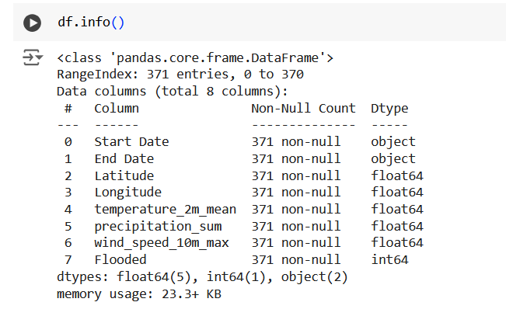
Exploratory Data Analysis and Feature Engineering
The dataset contains 371 entries with the following columns:
Start Date & End Date: Start and end dates of the analyzed events.
Latitude & Longitude: Geographical coordinates of the studied locations.
temperature_2m_mean: Average temperature at 2 meters during the period.
precipitation_sum: Total precipitation (in mm) over the period.
rain_sum: Total rainfall recorded (in mm).
wind_speed_10m_max: Maximum wind speed at 10 meters (in m/s).
Flooded: Binary indicator (1 = flood occurred, 0 = no flood).
Notes:
FTs like precision agriculture, remote sensing & AI-powered forming equipment can help increase agricultural productivity in LDCs. This can improve fiid security & contribute to the achievement of SDG 2 (Zero Hunger).

Slide 12
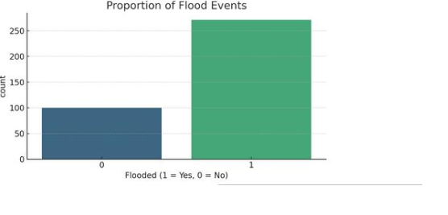
Exploratory Data Analysis and Feature Engineering
A significant portion of the dataset corresponds to flood events (Flooded = 1),
which may influence the balance of the machine learning model and require addressing(weighting)
Notes:
FTs like precision agriculture, remote sensing & AI-powered forming equipment can help increase agricultural productivity in LDCs. This can improve fiid security & contribute to the achievement of SDG 2 (Zero Hunger).

Slide 13
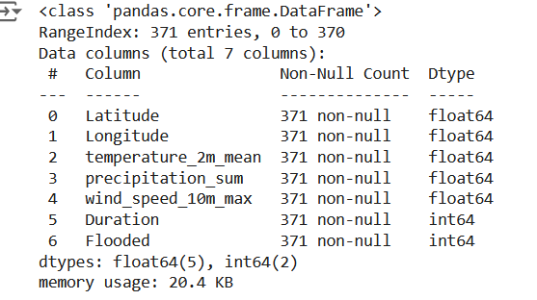
Exploratory Data Analysis and Feature Engineering
We add duration feature which is the number of days between the start date and the end date of the observation period and remove the start date and end date from the dataset
Notes:
FTs like precision agriculture, remote sensing & AI-powered forming equipment can help increase agricultural productivity in LDCs. This can improve fiid security & contribute to the achievement of SDG 2 (Zero Hunger).

Slide 14
Model
Notes:
FTs like precision agriculture, remote sensing & AI-powered forming equipment can help increase agricultural productivity in LDCs. This can improve fiid security & contribute to the achievement of SDG 2 (Zero Hunger).

Slide 15
Model Selection and Training
Firstly we used a model called Random Forest, which gave us a good start in making predictions
Secondly we switched to XGBoost, a more advanced machine learning algorithm.Why XGBoost? It's faster, more efficient, and better at handling complex patterns in data.
Notes:
FTs like precision agriculture, remote sensing & AI-powered forming equipment can help increase agricultural productivity in LDCs. This can improve fiid security & contribute to the achievement of SDG 2 (Zero Hunger).

Slide 16
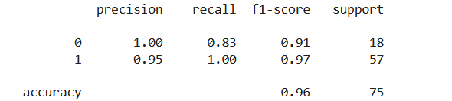
Model Evaluation and Hyperparameter Tuning
we trained a basic version of the XGBoost model to see how well it performs and we obtain these results :
Notes:
FTs like precision agriculture, remote sensing & AI-powered forming equipment can help increase agricultural productivity in LDCs. This can improve fiid security & contribute to the achievement of SDG 2 (Zero Hunger).

Slide 17
Model Evaluation and Hyperparameter Tuning
Confusion Matrix for a baseline XGBOOST shows that :
Correctly predicted: 15 cases of "0" and 57 cases of "1".
Misclassified: 3 cases of "0" as "1".
Notes:
FTs like precision agriculture, remote sensing & AI-powered forming equipment can help increase agricultural productivity in LDCs. This can improve fiid security & contribute to the achievement of SDG 2 (Zero Hunger).

Slide 18
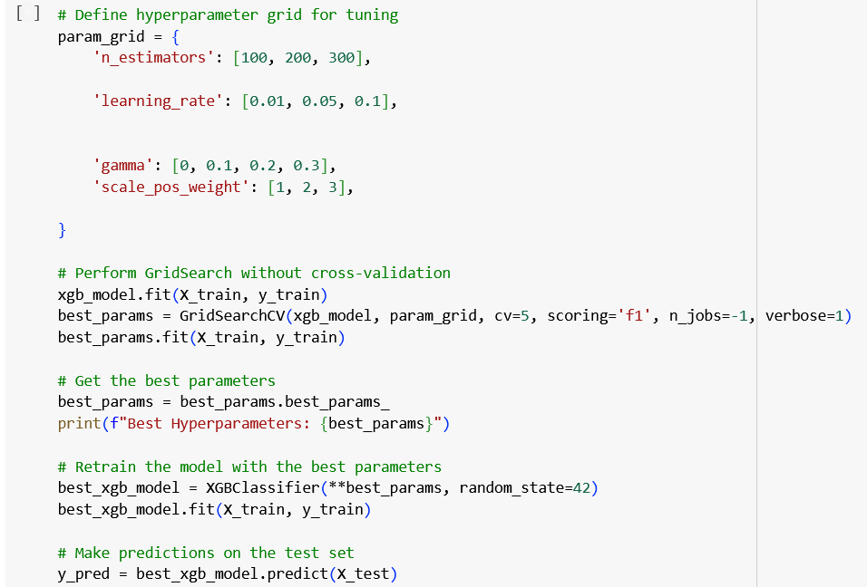
Model Refinement and Testing
To improve the model's performance, GridSearch cross validation was used to explore a range of hyperparameters, including n_estimators, learning_rate, gamma, and scale_pos_weight. The objective was to identify the optimal combination that maximizes the F1 score, ensuring a balanced trade-off between precision and recall and to address the issue of dataset imbalance by assigning greater importance to underrepresented class (class 0) to enhance prediction accuracy across all labels.
Notes:
FTs like precision agriculture, remote sensing & AI-powered forming equipment can help increase agricultural productivity in LDCs. This can improve fiid security & contribute to the achievement of SDG 2 (Zero Hunger).

Slide 19
Results
Notes:
FTs like precision agriculture, remote sensing & AI-powered forming equipment can help increase agricultural productivity in LDCs. This can improve fiid security & contribute to the achievement of SDG 2 (Zero Hunger).

Slide 20
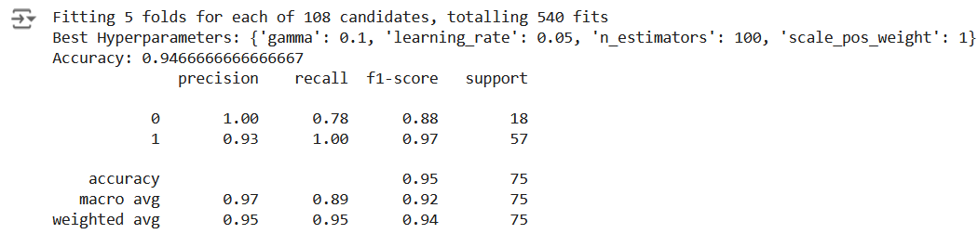
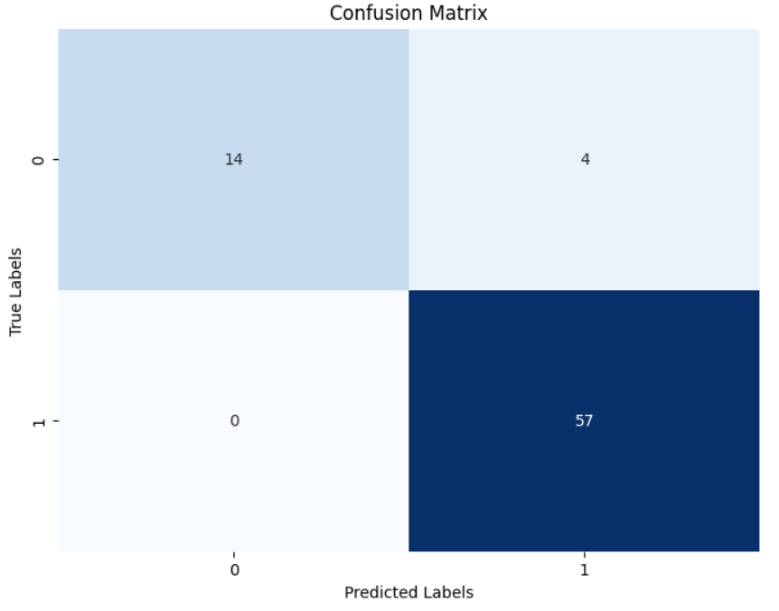
Evaluation Results
For the refined model we obtained these results:
For the confusion matrix:
Notes:
FTs like precision agriculture, remote sensing & AI-powered forming equipment can help increase agricultural productivity in LDCs. This can improve fiid security & contribute to the achievement of SDG 2 (Zero Hunger).

Slide 21
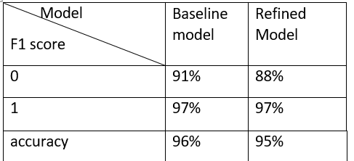
Evaluation Results
Our aim was to increase the f1 score compared to the baseline model the f1 score decrease.
Notes:
FTs like precision agriculture, remote sensing & AI-powered forming equipment can help increase agricultural productivity in LDCs. This can improve fiid security & contribute to the achievement of SDG 2 (Zero Hunger).

Slide 22
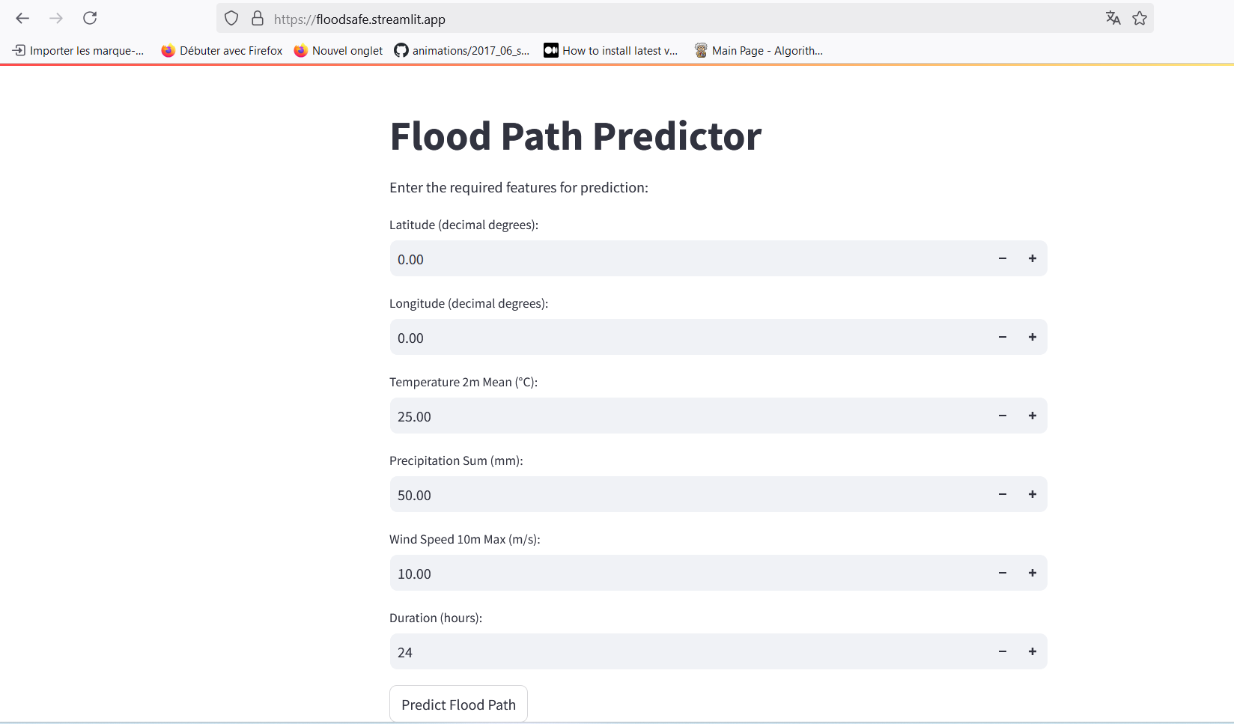
Deployment
The model has been successfully deployed as a user-friendly web application, accessible online at the followingURL:
https://floodsafe.streamlit.app/
Notes:
FTs like precision agriculture, remote sensing & AI-powered forming equipment can help increase agricultural productivity in LDCs. This can improve fiid security & contribute to the achievement of SDG 2 (Zero Hunger).

Slide 23
Future Work
Real-World Testing:
To assess the true performance of the model, it is essential to test it in a real-world environment. This will provide insights into its practical usability and reliability under real-time conditions.
Geographical Generalization:
Currently, the dataset is specific to India, which may limit the model's accuracy and adaptability in other geographical regions. Expanding the dataset to include diverse environmental and geographical contexts will improve the model's robustness and applicability worldwide.
Incorporating Dynamic Data:
Future iterations could integrate real-time data sources, such as live weather updates and river flow measurements, to enhance the predictive capabilities of the model.
Notes:
FTs like precision agriculture, remote sensing & AI-powered forming equipment can help increase agricultural productivity in LDCs. This can improve fiid security & contribute to the achievement of SDG 2 (Zero Hunger).

Slide 24
References
The paper "Flood Forecasting and Warning System: A Survey of Models and Their Applications in
West Africa" by Mohamed Fofana et al. provides an overview of flood forecasting models and their
practical applications in West African contexts. The study reviews traditional hydrological models,
hybrid approaches, and modern technologies utilized for flood prediction and warning systems
The paper ”Flood Prediction using Hydrologic and ML-based Modeling: A Systematic
Review by Vishal H. Goyal et al “systematically reviews recent advancements in flood
prediction methods, focusing on the integration of machine learning (ML) with traditional
hydrological models. It highlights the strengths, limitations, and applications of these
approaches in various regions.
Notes:
FTs like precision agriculture, remote sensing & AI-powered forming equipment can help increase agricultural productivity in LDCs. This can improve fiid security & contribute to the achievement of SDG 2 (Zero Hunger).

Slide 25


Thank you!

